Slide 1






T: +6012 502 3566
E: enquiry@actomate.ai
W: www.actomate.ai
Introduction to Data Cleaning in R
Lim Jone Keat
Technology Development Lead
24th March 2025
Copyright © Actomate 2025. All rights reserved.

Slide 2
Table of Contents
Contents | Page
A. What is Data Cleaning? | 3
B. Why we do Data Cleaning? | 4
C. How to do Data Cleaning? | 5
D. Case Study: A Paid Claims example | 6
E. Q&A | 7

Slide 3
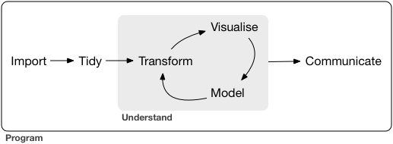
What is Data Cleaning?
Tidy the data into a more structured format and extract useful information for our analysis.
Image taken from R for Data Science 2nd edition: https://r4ds.had.co.nz/introduction.html

Slide 4
Why we do Data Cleaning?
Data is not always in ‘clean’ format.
We want to focus on questions about the data, not data itself.
To streamline the workflow, so we don’t struggle repeatedly to find optimal representation for different analysis.

Slide 5

How to do Data Cleaning?
There are numerous ways in R to clean data, but today we will just learn the `data.table` way.
https://github.com/Rdatatable/data.table

Slide 6
Case Study: A Paid Claims example
Let’s start to practice!

Slide 7


Q&A

